Slide 1
Auk Disturbance
Project Development Manager
Recruitment pack

Slide 2
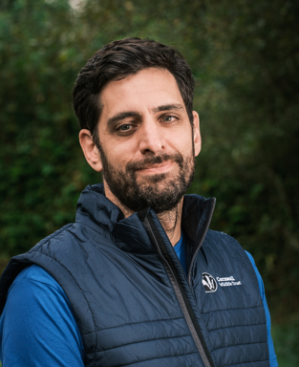
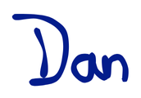
Introduction
Thank you for your interest in the role of Auk Disturbance Project Development Manager, a key position in a new initiative tackling the challenges and opportunities of offshore wind expansion.
As the UK transitions away from oil and gas, offshore wind has grown to become a major part of our energy mix. But this growth must go hand in hand with protecting wildlife. Seabirds such as guillemots and razorbills face increasing pressures.
This project, hosted by Cornwall Wildlife Trust with the Offshore Wind Industry Council (OWIC), the University of Exeter and funded by a consortium of developers, aims to deliver evidence-led solutions to reduce auk disturbance along Cornwall’s coast. This development phase will shape the programme that will follow, that will directly inform national policy and shape future ecological compensation mechanisms.
As Project Development Manager, you will coordinate partners and the research program, manage delivery staff, and oversee surveys, site prioritisation, and stakeholder engagement. Your leadership will ensure that the project delivers credible, transferable evidence that influences how offshore wind grows while safeguarding marine biodiversity.
This is an exciting opportunity to shape the balance between renewable energy and marine conservation at a critical moment for both.
We look forward to your application.
Dan Barrios O’Neill
Head of Marine Conservation, Cornwall Wildlife Trust

Slide 3
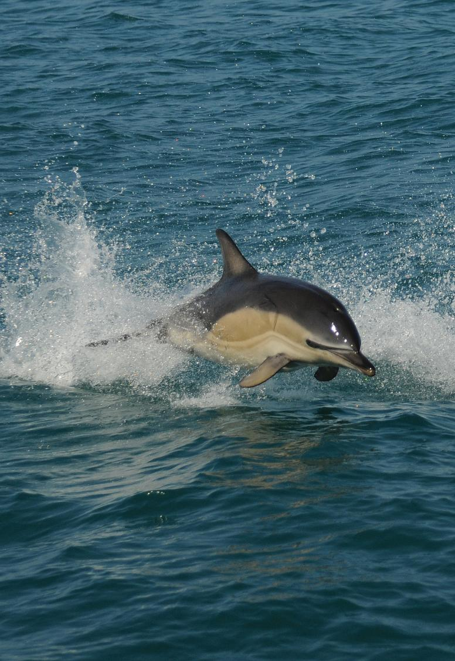
About us
Cornwall is home to some of the UK’s most remarkable marine life, including common dolphins.
For over 60 years, Cornwall Wildlife Trust has been working to protect Cornwall’s wildlife and wild places.
Today, our vision is of a Cornwall where nature thrives, with our wildlife and wild places valued and enjoyed by all. A Cornwall where currently rare and threatened species are once again a normal part of our countryside, skies and seas. Where healthy oceans, soils, rivers, wetlands, woodlands, moors, grasslands, sand dunes and other ecosystems are recognised for the roles they play. Where every child in Cornwall grows up with access to beaches and green spaces. And where we’re all connecting with, benefiting from and taking action for nature.
But we know we can’t achieve this vision alone, and that’s why our 2030 Strategy for Nature Recovery in Cornwall focuses on ensuring more areas of land and sea are managed well for wildlife, by informing, involving and inspiring more people, from all spheres, to take action for nature. We’re delivering this through four impact objectives:
Demonstrating what is possible and Inspiring others through our conservation delivery.
Supporting and Advising others on how to reduce negative pressures and create positive outcomes for wildlife.
Engaging and Mobilising individuals and groups to use their time and resources to participate in practical action.
Campaigning and Advocating for better decisions for nature from those in power.
With muddy hands, spades in the ground, and wetsuits ready, we are deeply rooted in the local Cornish community. But while a local, independent charity, we are part of a national movement of 46 Wildlife Trusts, all with the shared purpose of restoring our natural world.
Photo: Adrian Langdon

Slide 4
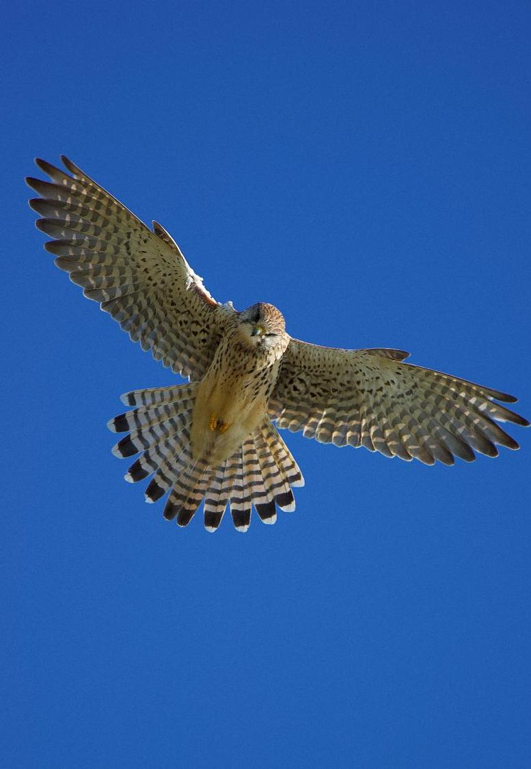
Our values
Every person in Cornwall Wildlife Trust has an important role living our values as we work towards a Cornwall where nature thrives.
At Cornwall Wildlife Trust, our values are at the heart of everything we do. They inspire us to protect and restore Cornwall’s natural environment, to act with conviction, and to nurture a deep connection between people and nature. They remind us that lasting change is only possible when we work together, guided by passion, purpose, and evidence. These values are:
We are Passionate and Inspiring: We believe in our vision of a Cornwall where nature thrives and know that what we do matters. We are committed to our work and inspire others to join us.
We are Knowledgeable and Authentic: We bring expertise and credibility to our work, ensuring actions and decisions are grounded in integrity, accountability, evidence and practicality.
We are Inclusive and Enabling: We know we cannot turn the tide on nature’s decline alone and that everyone has a role to play. We listen to, learn from, collaborate with, involve, educate and empower others to deliver change.
We are Focused and Impactful: We are ambitious and determined to deliver impact. We recognise the need to be creative, applying bold new approaches alongside the things we know already work.
Photo: Sam Baker
Photo: Sam Baker

Slide 5
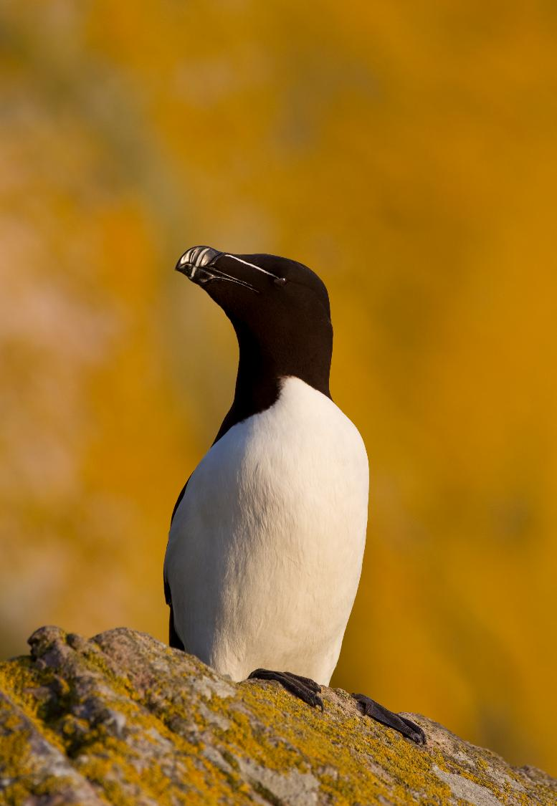
Razorbills are just one of the auk species threatened by marine disturbance, which can harm their breeding and feeding habits.
Role summary
The Auk Disturbance Project Development Manager will lead Cornwall Wildlife Trust’s role in the final stages of development of the Reducing Auk Disturbance programme – a major partnership tackling the impact of offshore wind on seabirds such as guillemots and razorbills. Supported financially by offshore wind developers, this strategically significant project will shape the future delivery phase intended to generate evidence to inform future policy and compensation mechanisms, including the Marine Recovery Fund.
The role involves overseeing this development stage, managing relationships with partners and stakeholders (including Defra, Natural England, OWIC and COWSC), and planning future work to provide credible, scalable evidence on disturbance reduction. This is a unique opportunity to drive forward an initiative with tangible conservation impact and long-term influence on national policy.
Salary: £32,000 - £36,000 per annum, depending on experience
Hours: Full time (37.5 hours)
Contract type: Fixed Term 12-month contract, subject to confirmation of funding. While the initial focus is on shaping and delivering the development phase, the role is intended to lay the groundwork for a further longer-term delivery phase, which may begin within this 12-month period.
Location: Cornwall Wildlife Trust’s HQ, based in our Five Acres nature reserve, with regular working from home supported. Requires travel within Cornwall
Reports into: Head of Marine Conservation
Key relationships: Collaboration on Offshore Wind Strategic Compensation (COWSC), University of Exeter, Defra, Natural England and the Offshore Wind Industry Council OWIC)
Photo: Peter Cairns

Slide 6
Responsibilities
  Regulatory and Programme Alignment
  Act as the key point of contact between Cornwall Wildlife Trust and the developer group, ensuring regular updates, clear communication, and responsiveness to evolving needs
  Work closely with project partners and statutory stakeholders to ensure planned delivery aligns with national frameworks for offshore wind ecological compensation
  Engage the COWSC Gateway Group, Natural England, Defra, and OWIC to ensure proposed delivery phase project outputs are relevant and influential at a strategic level
  Support discussions on the potential future recognition of reducing disturbance as an approved compensation measure through national mechanisms (e.g. Marine Recovery Fund), while focusing on the practical needs of the current development phase
  Project Coordination and Delivery
  Plan the detailed implementation, and proposed evaluation of future project activities across all workstreams and multiple sites
  Monitor progress against the 12-month delivery plan, ensuring key milestones are met and risks are managed
  Coordinate with proposed delivery partners, including University of Exeter, GoBe Consultants, Cornwall Marine & Costal Code Groups, WiSe, and local conservation groups
  Oversee internal reporting and contribute to external reporting, including updates to the developer group and project steering group
  Team Leadership and Capacity Building
  Develop structure of delivery team and staffing needs
  Lead on preparing for recruitment and onboarding of new project staff, including two Project Officers and seasonal staff
  Line manage project delivery staff and support training and capacity-building across teams
  Financial Management and Administration
  Manage the project budget in line with agreed forecasts, ensuring spending is monitored, tracked, and reported. Get consensus on scope of delivery phase funding and use that to develop fully costed programme of work
  Support procurement, grant administration, and contract management in line with organisational and funder requirements
  Field Support and Flexibility
  Provide additional capacity for fieldwork delivery including assisting with seabird monitoring, data collection, and on-water interventions where appropriate
  Partnership and Stakeholder Engagement
  Maintain effective communication with all stakeholders and partners
  Help facilitate the coordination of the project’s steering group and attend stakeholder meetings, workshops, and annual conferences

Slide 7
Person specification
Experience
  Leadership of conservation projects and partnerships (E)
  Managing environmental or conservation projects from design through delivery (E)
  Working with or alongside government agencies, regulators, or industry partners (E)
  Budget management, financial reporting and procurement (E)
  Recruiting, line managing, and supporting staff and volunteers (D)
  Fieldwork in coastal or remote environments, ideally including seabird monitoring (D)
  Marine seagoing fieldwork experience and associated qualifications (D)
Skills
  Ability to manage competing priorities and complex workstreams (E)
  Producing clear reports and project updates for multiple audiences (E)
  Effective project planning, delivery and evaluation across research, engagement, and communications (E)
  Excellent communication and partnership-building, with confidence in representing the Trust at external meetings (E)
  Stakeholder coordination, including developers, statutory bodies and community groups (E)
  Logistical and operational problem-solving in support of field and monitoring work (E)
  Experience delivering public or stakeholder engagement (D)
Knowledge
  Understanding of national frameworks for ecological compensation and strategic mechanisms, such as the Marine Recovery Fund (D)
  Familiarity with licensing, safety and data collection standards relevant to fieldwork (D)
  Awareness of seabird conservation, marine policy, and ecological monitoring (D)
  Knowledge of recreational disturbance impacts and offshore wind development pressures (D)
  Awareness of health and safety standards for remote and marine fieldwork (D)
Personal qualities
  Strategic mindset with the ability to balance immediate delivery with long-term vision (E)
  Adaptable and resilient, able to manage change and shifting priorities (E)
  Collaborative approach, comfortable working across sectors and disciplines (E)
  Clear communicator with ability to engage multiple stakeholder groups (E)
  Passionate about marine conservation and motivated to achieve practical outcomes for wildlife (E)
  Full driving licence and willingness to travel throughout Cornwall (E)
Please note
(E) indicates essential. (D) indicates desirable
Some locations in the project will likely be underserved by public transport. It is therefore desirable that candidates have a driving licence

Slide 8
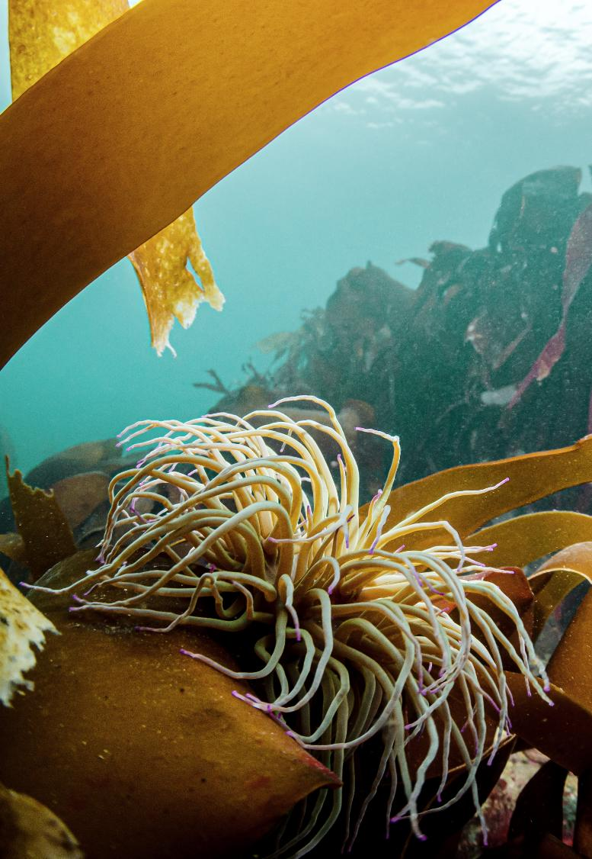
Finally…
Other details
Enhanced company holiday entitlement – 25 days plus bank holidays, with additional time off between Christmas and New Year.
Cornwall Wildlife Trust offers excellent flexible working and TOIL arrangements.
Employees have access to the Employee Assistance Programme (24/7 counselling service) and Employee health and wellbeing portal upon successful completion of probationary period (three months).
Stakeholder pension of 5% employer contribution.
To apply
Please send a CV and supporting statement outlining your suitability against the person specification to recruitment@cornwallwildlifetrust.org.uk by midnight on Thursday 2nd October.
Thank you for your interest in joining work to create a Cornwall where nature thrives.
Photo: Harvey Pringle

Slide 9
Photo: Peter Cairns

