Slide 1
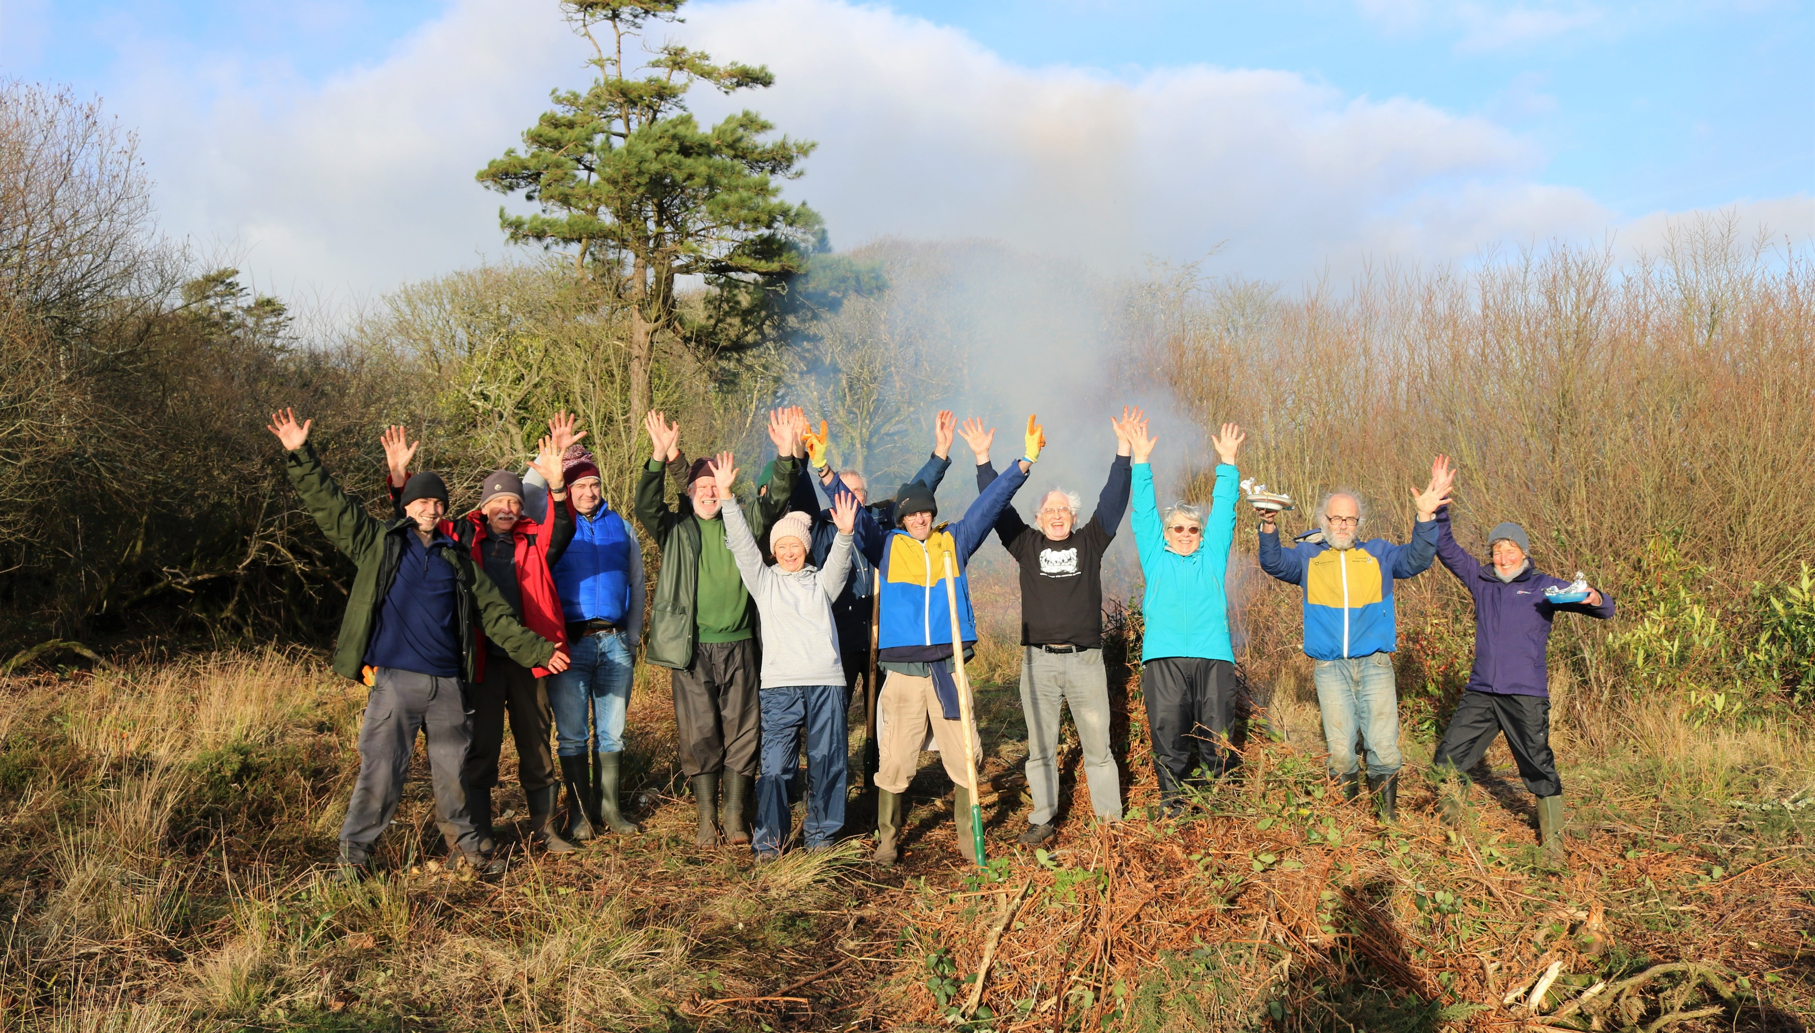
2023 volunteer awards

Slide 2
Thank you!

Slide 3
Young volunteer award
For a volunteer aged 18-30 who has made a significant difference to Cornwall’s wildlife.
Zeni Hayton

Slide 4
Group award
For a group of volunteers whose collective work has made a significant difference to Cornwall’s wildlife.
Wild Cober

Slide 5
Wildlife champion award
For a volunteer who has shown remarkable commitment to supporting our work over the past 12 months (and potentially beyond).
Sue Allen

Slide 6
Lifetime achievement award
For a volunteer who has demonstrated great commitment and dedication to wildlife conservation over many years.
Delia Webb

